Slide 1
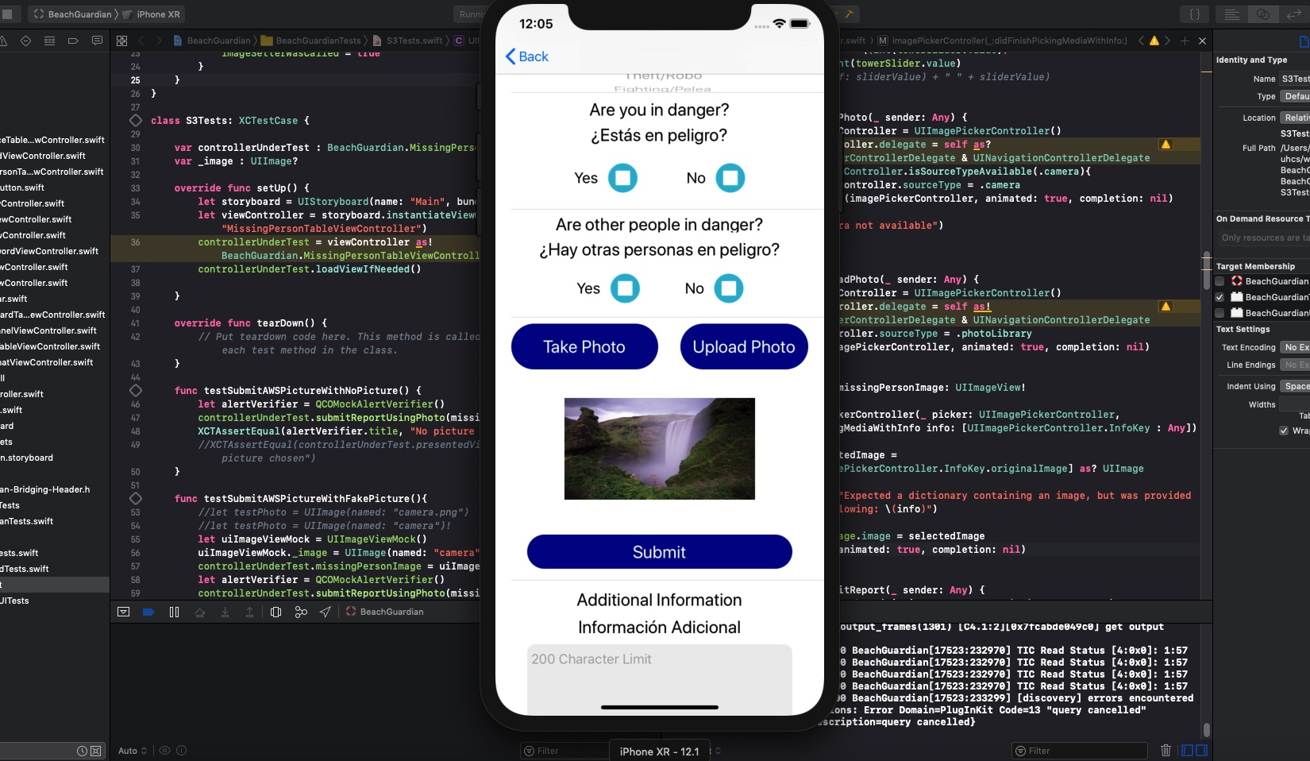
Edward – Week 7 (1)
This past week consisted of moving forward with updates into the repo, cleaning up code to improve code coverage, adding to new forms, and rounding out testing with tests for AWS S3.

Slide 2
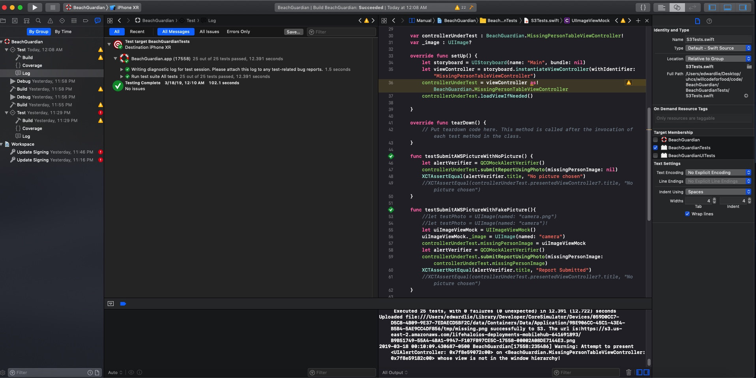
Edward – Week 7 (2)
Update to repo made on Wednesday, 3/13
Tests passing for main tab bar
Tests passing for S3 in missing person table view controller

Slide 3
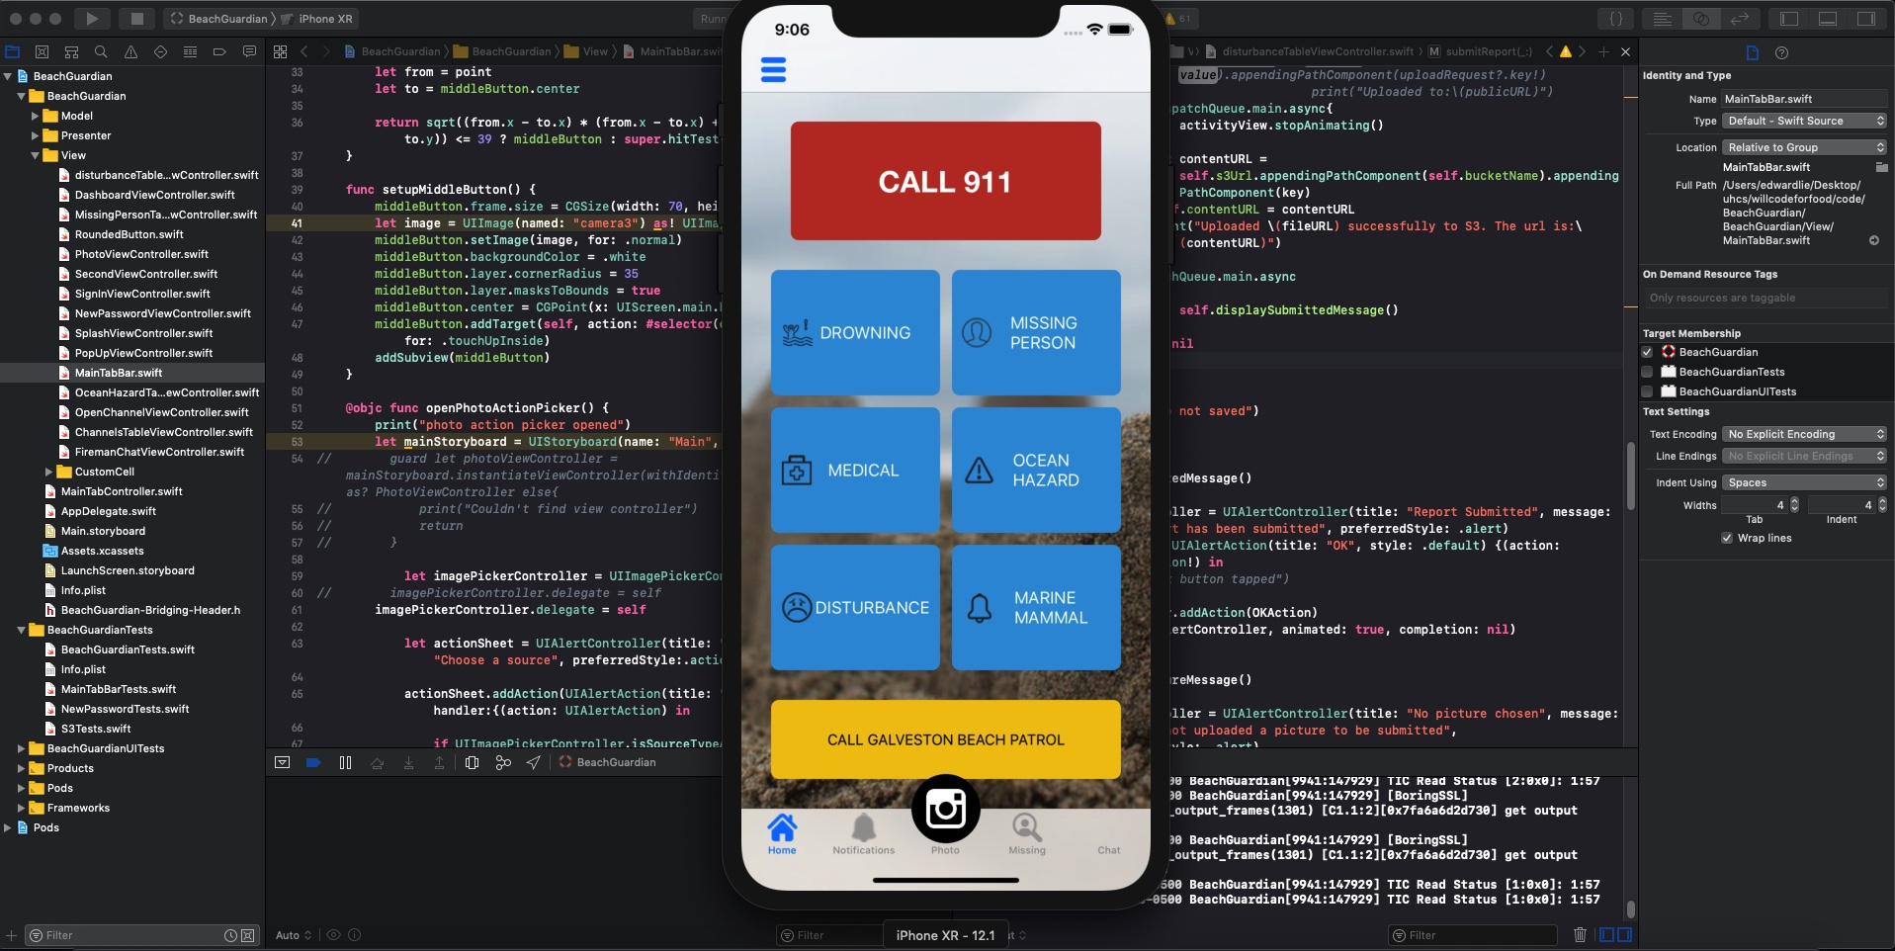
Edward – Week 7 (3)
Started adding to the disturbance and ocean hazard forms.
Photo icon updated
My week 8 goal is to continue with TDD to develop the remaining features in the application making sure to continue creating and passing all unit tests.

